Slide 1
Urogenital System
M. AL-Badran
CABM( Medicine) FIBMS (Rheumatology)

Slide 2
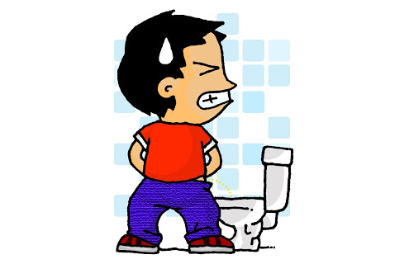
Dysuria and Urogenital Pain
Dysuria is pain or discomfort felt during or immediately after passing urine
It is often described as a 'burning' sensation felt at the urethral meatus, or the suprapubic region
Causes
Infection and/or inflammation of the bladder (cystitis)
Prostatitis and urethritis

Slide 3
Pain (SOCRATES)
Notes
Note 1
Constant loin pain and systemic upset (fever and rigors) coexist with dysuria suggests infection of the kidney (acute pyelonephritis)
Note 2
Chronic dull aching discomfort in the loin and renal angle may occur in chronic renal infection and scarring
Vesicoureteric reflux
Adult polycystic kidney disease
Chronic urinary tract obstruction

Slide 4
Note 3
Renal 'colic' is not a true colic as the pain is unremitting
The pain is usually of sudden onset, severe and sustained
The patient is restless, nauseated and often vomits
The pain may radiate from the renal angle and loin to the iliac fossa, the groin and into the genitalia

Slide 7
Frequency and Urgency
Frequency is increased frequency of micturition without an increase in the total urine volume
Urgency is a sudden strong need to pass urine and results in incontinence if the person has no opportunity to urinate
Causes
Lower urinary tract infection
Tumours
Stones
Urinary tract obstruction

Slide 8
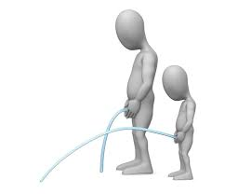
Note: In men > 40 years, enlargement of the prostate gland causes
Frequency with the passage of small volumes of urine
Impaired urinary flow
Hesitancy (delay in initiating urine flow)
Post Voiding dribbling of urine

Slide 9
Polyuria, Nocturia, Oligo/Anuria
Urine output approximately equal to the fluid intake minus the insensible fluid losses through the skin and respiratory tract (500-800 ml/day).
Urine output is usually 2-3 liter per day

Slide 10
Polyuria is the production of an abnormally large volume of urine
Cause
Excessive fluid intake (Psychogenic polydipsia)
The use of diuretic drugs
Hyperglycaemia and glycosuria in diabetes mellitus leading to an osmotic diuresis
Diabetes insipidus: lack of antidiuretic hormone (ADH) from the pituitary gland in cranial or resistant to antidiuretic hormone (ADH) in nephrogenic type
Failure of aldosterone secretion by the adrenal gland in Addison's disease

Slide 11
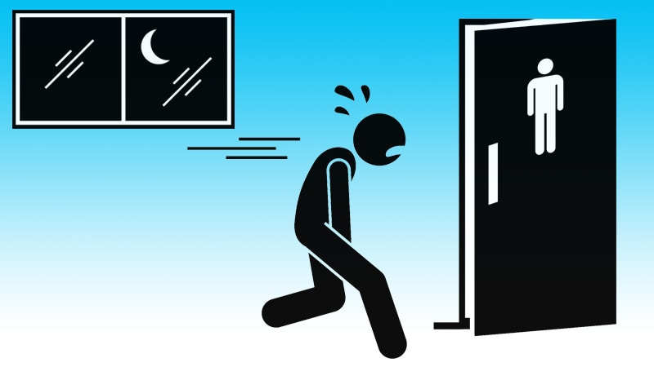
Nocturia is the need to wake up at night twice to pass urine (non-specific symptom)
Note 1: Nocturia can be a very early symptom of chronic renal failure
Note 2: Nocturia common symptom of cardiac failure, the diuresis resulting from the improvement in renal blood flow which occurs on lying flat

Slide 12
Oliguria is a reduction in the urine volume to < 800 ml/day
Causes
Very low fluid intake
May indicate loss of kidney function
Note: Acute renal failure is usually associated with oliguria, but 20% of patients have non-oliguric acute renal failure and this can only be diagnosed by biochemical testing of renal function

Slide 13
Anuria is the total absence of urine production, suggests urinary tract obstruction (Look for a mechanical explanation)
Notes:
Shock , renal cortical necrosis and bilateral obstruction

Slide 14
Urinary Incontinence
Urinary incontinence is the involuntary passing of urine
Urge incontinence is when an urgent need to urinate cannot be resisted
Stress incontinence is when leakage of urine occurs in response to situations that increase intra-abdominal pressure, such as coughing, sneezing or laughing (Multiparous women experience stress incontinence because of weakness of pelvic floor muscles)

Slide 16
HAEMATURIA
Haematuria is the presence of red blood cells in the urine, due to bleeding from the kidneys or urinary tract
Painless macroscopic haematuria
Benign bladder papilloma
Cancer of the kidney, bladder or prostate
Glomerulonephritis (most commonly IgA nephropathy)
Polycystic kidney disease
Chronic renal infection such(tuberculosis, Bilhariziasis)

Slide 17
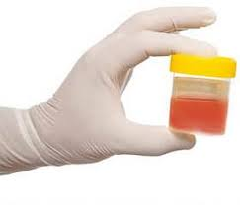
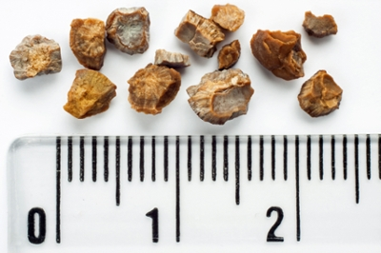
Painful macroscopic haematuria
Urinary tract infection
Renal calculi with obstruction

Slide 18
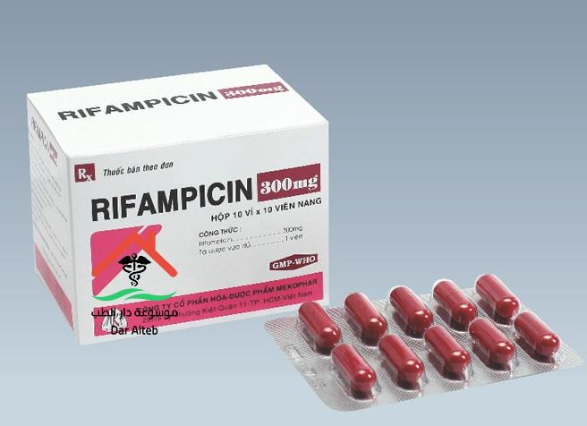
Red Colored urine
Blood, free haemoglobin in hemolysis, myoglobin in rhabdomyolysis
Drugs - Rifampicin, Metronidazole, Warfarin
Beetroot, blackberries

